Slide 1
SEMI SOLID VEHICLES
DR.RAMYA S.S
ASSISTANT PROFESSOR
DEPT OF HOMOEOPATHIC PHARMACY

Slide 2
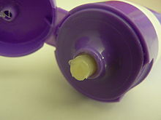
LANOLIN

Slide 3
LANOLIN
SYNONYMS:Wool fat,Adeps lanae,Adepes lan
PREPARATION:Lanolin (from Latin lāna ‘wool’, and oleum ‘oil’), is a wax secreted by the sebaceous glands of wool-bearing animals. Lanolin used by humans comes from domestic sheep breeds that are raised specifically for their wool. however, as lanolin lacks glycerides , it is not a true fat. Lanolin's waterproofing property aids sheep in shedding water from their coats. Certain breeds of sheep produce large amounts of lanolin.
Lanolin's role in nature is to protect wool and skin from climate and the environment; it also plays a role in skin hygiene.Lanolin and its derivatives are used in the protection, treatment and beautification of human skin.

Slide 4
PROPERTIES OF LANOLIN
A PALE YELLOW,TENACEOUS,UNCTUOUS SUBSTANCE
ODOUR,faint and characteritc
SOLUBILITY:Insoluble in water,sparingly soluble in cold alcohol,freely soluble in solvent ether and in CHCL3
MELTING RANGE:36-42
ACID VALUE:Not more than 1
IODINE VALUE:18-32
SAPONIFICATION VALUE:92-106

Slide 5
Lanolin –Uses
It is used extensively in both the personal care (e.g., high value cosmetics, facial cosmetics, lip products) and health care sectors such as topical liniments. Lanolin is also found in lubricants, rust-preventive coatings, shoe polish, and other commercial products.
It is frequently used in protective baby skin treatment and for sore nipples in breastfeeding mothers.
The water-repellent properties make it valuable in many applications as a lubricant grease where corrosion would otherwise be a problem.
7-Dehydrocholesterol from lanolin is used as a raw material for producing vitamin D₃ by irradiation
Lanolin can also be restored to woollen garments to make them water and dirt repellent, such as for cloth diaper covers.
Lanolin is also used in lip balm products such as Carmex. For some people, it can irritate the lips.
Lanolin is sometimes used by people to reduce irritation with masks, particular nasal pillow masks that can often create sore spots in the nostrils.

Slide 6
UTILITY IN HOMOEOPATHY
DUE TO PENETRATING POWER WITH IN THE SKIN ,EXTENSIVELY USED IN OINTMENTS

Slide 7
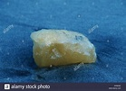
SPERMACETI
Spermaceti (from Greek sperma meaning "seed", and ceti, the genitive form of "whale") is a waxy substance found in the head of Sperm whale. Spermaceti is created in the spermaceti organ inside the whale's head.
Synonyms:Cetaceum

Slide 8
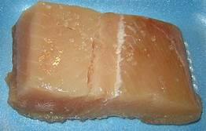
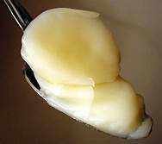
PREPARED LAD It is the purified internal fat of the abdomen of HOG,prepared by careful removal of the membranes and adhering flesh USE:As an ingredient in ointments

Slide 9
ISIN GLASS
It is a collagen derived from the thin,inner silvery layer of the air bladder of some fishes
USES:It is a component of CALENDULA and ARNICA plasters

Slide 10
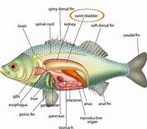
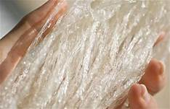
ISIN GLASS
It is a collagen derived fro the thin inner silvery layer of the air bladder of some fishes USES: It is a component of CALENDULA and ARNICA plasters

